Slide 1
Synthesizing GSBPM Updates

Slide 2
Update
Environment not ready for testing
(Radia) Proof-of-concept synthesizing one draft GSBPM update, from one deck.
2nd workflow designed but needs input.

Slide 3
Proof-of-Concept

Slide 4
Original description
{"id": "4.4",
"text": "Finalise collection",
"description": "This sub-process includes loading the collected data and metadata into a suitable electronic environment for further processing. It may include manual or automatic data capture, for example, using clerical staff or optical character recognition tools to extract information from paper questionnaires, or converting the formats of files or encoding the variables received from other organisations. It may also include analysis of the metadata and paradata associated with collection to ensure the collection activities have met requirements. In cases where there is a physical collection instrument, such as a paper questionnaire, which is not needed for further processing, this subprocess manages the archiving of that material. When the collection instrument uses software such as an API or an app, this sub-process also includes the versioning and archiving of these."}

Slide 5
Draft description
{"id": "4.4",
"text": "Finalise collection",
"description": "This sub-process includes loading the collected data and metadata into a suitable electronic environment for further processing. When handling 'risky' or sensitive data, this involves utilizing designated 'trusted environments' equipped with confidential computing and other emerging technologies, adhering to enhanced security, privacy, and confidentiality protocols during ingestion and management. Data capture, whether manual or automatic (e.g., clerical, OCR, format conversion, variable encoding), may be performed internally or managed through the receipt, verification, and oversight of data and metadata loaded by external suppliers. Following the loading and an initial analysis of associated metadata and paradata to confirm that collection activities have met requirements, the collected data and metadata undergo a formal 'certification' by subject matter specialists, serving as an explicit quality assurance and accountability gate. The data finalized and certified in this sub-process, especially when originating from or processed within a trusted environment, is designated as the definitive 'master copy' for subsequent stages, thereby eliminating duplicative data holdings. Finally, this sub-process also manages the archiving of physical collection instruments (such as paper questionnaires) and includes the versioning and archiving of software-based collection instruments (like APIs or apps)."}

Slide 6
Workflow

Slide 7
Workflow outline
Apply structure to GSBPM content
Extract updates from strategic decks
Layer-in AI reasoning on updates
Aggregate updates per GSBPM (sub-)phase description
LLM drafts updated description

Slide 8
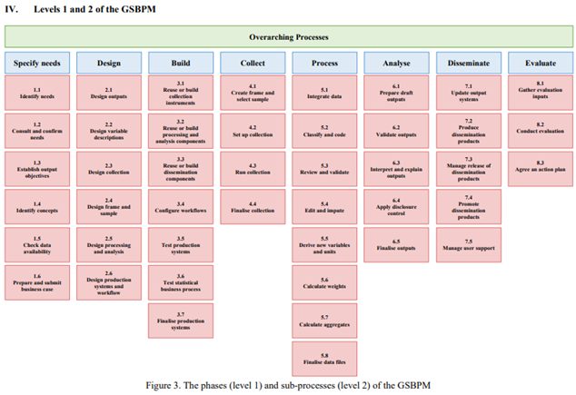
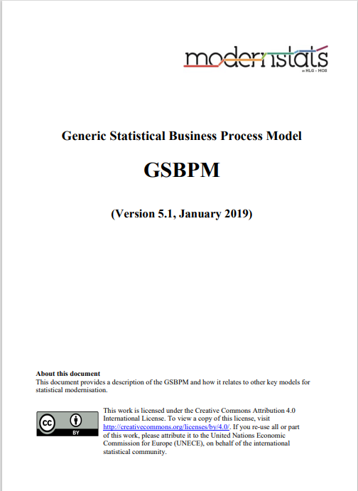

1. Apply structure to GSBPM content
Extract data from GSBPM documentation

Slide 9
1. Structured GSBPM output
[ {"phase": "Specify needs",
"description": "This phase is triggered when a need for new statistics is identified or feedback about current statistics initiates a review. It includes all activities associated with engaging stakeholders to identify their detailed statistical needs (current or future), proposing high level solution options and preparing a business case to meet these needs.",
"sub-processes": [
{"id": "1.1",
"text": "Identify needs",
"description": "This sub-process includes the initial investigation and identification of what statistics are needed and what is needed of the statistics. It may be triggered by a new information request or an environmental change such as a reduced budget. Action plans from evaluations of previous iterations of the process or from other processes might provide an input to this sub-process. It also includes consideration of practice amongst other (national and international) statistical organisations producing similar data and the methods used by those organisations."
},
{ "id": "1.2",
"text": "Consult and confirm needs",
"description": "This sub-process focuses on consulting with the internal and external stakeholders and confirming in detail the needs for the statistics. …

Slide 10

2. Extract updates from strategic decks
Extract update items from strategic deck
Classify update items according to applicable GSPBM items
GSBPM
updates

Slide 11
2. Extracted updates output data
[{“update": {
"reference": "Slide 2 - GSBPM Roadmap 2024-2025",
"description": "Overall focus: GSBPM as an adaptable, modern, and data source-agnostic model, emphasizing reproducibility, efficiency, and coherence. Strategic priorities targeted: Reproducibility, Efficiency, Coherence, Adaptability, Modern, Data Source-Agnostic.",
"implicated phases and subphases": [
{"justification": "This statement describes the overarching strategic direction and desired characteristics for the entire GSBPM model. It influences the interpretation and future development of all phases and sub-phases, rather than making a specific change to any single one.",
"id": "N/A",
"text": "All GSBPM Phases (Overall Model)"}
]}},
{ "update": {
"reference": "Slide 2 - GSBPM Roadmap 2024-2025",
"description": "A shift towards more modular and standardized components, facilitating reuse …
…

Slide 12
3. Extracted updates with reasoning
"update": {
"reference": "Slide 2 - GSBPM Roadmap 2024-2025",
"description": "A shift towards more modular and standardized components, facilitating reuse and interoperability. Strategic priorities targeted: Reusability, Interoperability, Efficiency.",
"implicated phases and subphases": [
{"justification": "This update explicitly mentions 'modular and standardized components' and 'facilitating reuse and interoperability', which are key aspects of design and implementation within the 'Design' and 'Build' phases.",
"id": "2",
"text": "Design"},
{"justification": "This update explicitly mentions 'modular and standardized components' and 'facilitating reuse and interoperability', which are key aspects of design and implementation within the 'Design' and 'Build' phases. Sub-processes 3.1, 3.2, and 3.3 particularly focus on reusing or building components.",
"id": "3",
"text": "Build"},
{"justification": "The concept of 'standardized com…

Slide 13
3. Layer-in AI reasoning on updates
Include implicated BSP descriptions adjacent to extracted update data
Have LLM articulate how the update would change each implicated BSP description.
Repeat for each update
GSBPM
updates
GSBPM
updates
GSBPM
updates
GSBPM Update
+ reasoning/phase
GSBPM
updates

Slide 14

4. Aggregate updates per GSBPM (sub-)phase
Include implicated BSP descriptions adjacent to extracted update data
Have LLM articulate how the update would change each implicated BSP description.
Repeat for each update
GSBPM
updates
GSBPM
updates
GSBPM
updates
GSBPM
updates
GSBPM
updates
GSBPM
updates
GSBPM Update
+
reasoning/phase
GSBPM phase
+ reasoning/update

Slide 15
4. Aggregate updates per GSBPM (sub-)phase
{"id": "4.4",
"text": "Finalise collection",
"updates": [
“{"reference": "8 - GSBPM Roadmap Data In",
"description": "Clear delineation sponsor (subject matter) roles and accountabilities, based on the minimum requirement that sponsors / subject matter are responsible for specification and certification (1.4, 1.5, 3.1, 4.4)",
"justification": "The update explicitly states that subject matter is responsible for 'certification' in this sub-process.",
"reasoning": "The description for sub-process 4.4 would need to be updated to explicitly include a step for 'certification' by subject matter specialists. This would involve adding a statement that the collected data and metadata, after initial loading and analysis, must undergo a formal certification process by relevant subject matter experts to ensure it meets specified requirements before proceeding to the 'Process' phase. This adds an explicit quality assurance and accountability gate."},
{"reference": "8 - GSBPM Roadmap Data In",
"description": "Full transfer of accountabilities for activities and functions related to data acquisition and collection to sup…

Slide 16
5. LLM drafts updated description
Include implicated BSP descriptions adjacent to extracted update data
Have LLM articulate how the update would change each implicated BSP description.
Repeat for each update
GSBPM
updates
Draft GSBPM
descriptions
GSBPM
updates
GSBPM
updates
GSBPM phase
+ reasoning/update

Slide 17
5. Draft descriptions
{"id": "4.4",
"text": "Finalise collection",
"description": "This sub-process includes loading the collected data and metadata into a suitable electronic environment for further processing. When handling 'risky' or sensitive data, this involves utilizing designated 'trusted environments' equipped with confidential computing and other emerging technologies, adhering to enhanced security, privacy, and confidentiality protocols during ingestion and management. Data capture, whether manual or automatic (e.g., clerical, OCR, format conversion, variable encoding), may be performed internally or managed through the receipt, verification, and oversight of data and metadata loaded by external suppliers. Following the loading and an initial analysis of associated metadata and paradata to confirm that collection activities have met requirements, the collected data and metadata undergo a formal 'certification' by subject matter specialists, serving as an explicit quality assurance and accountability gate. The data finalized and certified in this sub-process, especially when originating from or processed within a trusted environment, is designated as the definitive 'master copy' for subsequent stages, thereby eliminating duplicative data holdings. Finally, this sub-process also manages the archiving of physical collection instruments (such as paper questionnaires) and includes the versioning and archiving of software-based collection instruments (like APIs or apps)."}

Slide 18
